Slide 1
Lecture Notes on Mathematical Morphology: Grayscale Images

Slide 2
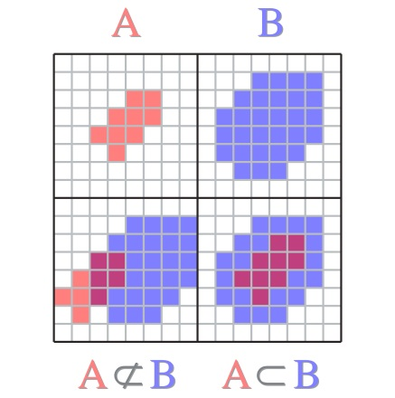
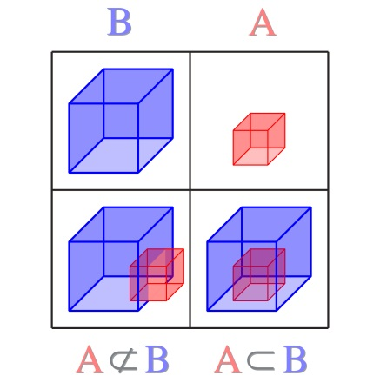
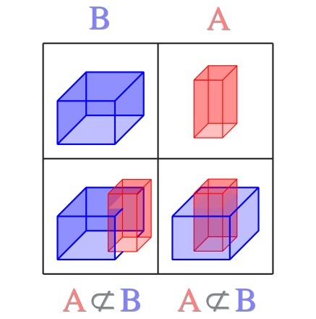
Grayscale Morphology
Grayscale morphology is a multidimensional generalization of the binary operations. Binary morphology is defined in terms of set-inclusion of pixel sets. So is the grayscale case, but the pixel sets are of higher dimension. In particular, standard R×C, 1-band intensity images and the associated structuring elements are defined as 3-D solids wherein the 3rd axis is intensity and set-inclusion is volumetric.
set inclusion
(explained on p. 11 )
(a) binary,
(b) & (c) grayscale
(a)
(b)
(c)

Slide 3
Recall: Types of Images
An image is a mapping, I, from a set, S_{P} , of pixel coordinates to a set, G, of values such that for every coordinate vector, p, there is a value I(p) drawn from G.
A real image maps an n-dimensional Euclidean vector space into the real numbers. Pixel coordinates and pixel values are real.
A discrete image maps an n-dimensional grid of points into the real numbers. Coordinates are n-tuples of integers, pixel values are real.
A digital image maps an n-dimensional grid into a finite set of integers. Pixel coordinates and pixel values are integers.

Slide 4
Extended Real Numbers
Let R represent the real numbers.
Define the extended real numbers, R*, as the real numbers plus two symbols, −∞ and ∞ such that
for all numbers x∈R.
That is if x is any real number, then ∞ is always greater than x and −∞ is always less than x. Moreover,
for all numbers x ∈ R.

Slide 5
Real Images
In mathematical morphology a real image, I, is defined as a function that occupies a volume in a Euclidean vector space. I comprises a set, S_{p}, of coordinate vectors (or pixel locations),
p, in an n-dimensional vector space ^{n}. Associated with each p is a value from *. The set of pixel locations together with their associated values form the image – a set in ^{n+1}:
Thus, a conventional, 1-band, R×C image is a 3D structure with S_{p} ⊂ ² and I(p)∈. By convention in the literature of MM, S_{p} ≡ ^{n}, a real image is defined over all of ^{n}.

Slide 6
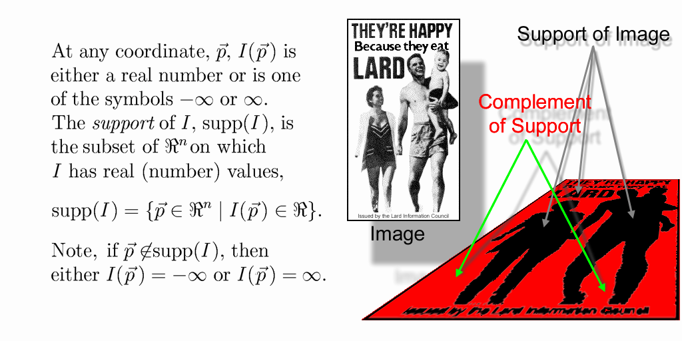
Support of an Image
The support of a real image, I, is
That is, the support of a real image is
the set pixel locations in ^{n} such that
I(p) ≠ −∞ and I(p) ≠ ∞.
The complement of the support is, therefore, the set of pixel locations
in ^{n} where
I(p) = −∞ or I(p) = ∞.

Slide 7
Grayscale Images
If over its support, I takes on more than one real value, then I is called grayscale.
The object commonly known as a black and white photograph is a grayscale image that has support in a rectangular subset of R². Within that region, the image has gray values that vary between black and white. If the intensity of each pixel is plotted over the support plane, then
is a volume in R³. In the abstraction of MM we assume the image does exist outside the support rectangle, but that I(p) = −∞ there.

Slide 8
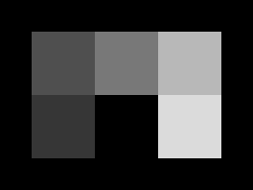
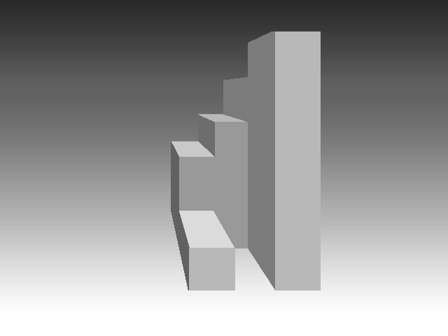
Grayscale Images
grayscale image
3D solid representation
In MM, a 2D grayscale image is treated as a 3D solid in space – a landscape – whose height above the surface at a point is proportional to the brightness of the corresponding pixel.

Slide 9
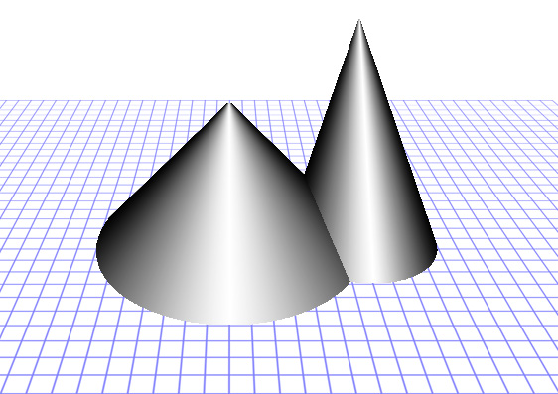
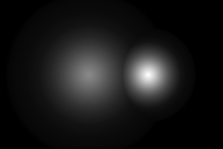
Representation of Grayscale Images
image
landscape
Example: grayscale cones

Slide 10
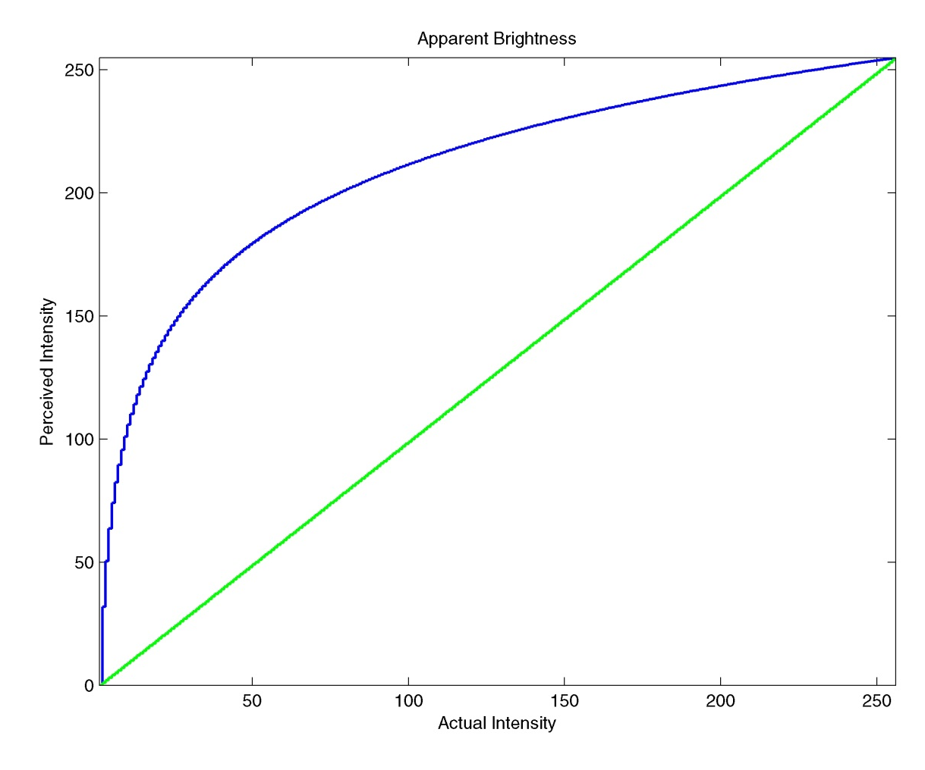
Aside: Brightness Perception
The previous slide demonstrates the Weber-Fechner relation. The linear slope of the intensity change is perceived as logarithmic.
The green curve is the actual intensity; the blue curve is the perceived intensity.

Slide 11
Set Inclusion in Grayscale Images
In grayscale morphology, set inclusion depends on the implicit 3D structure of a 2D image. If I and J are grayscale images then
That is J ⊆ I if and only if the support of J is contained in that of I and the value of J is nowhere greater than the value of I on the support of J.
J I
I J
I J
binary
grayscale
grayscale
J ⊄ I J ⊂ I
J ⊄ I J ⊂ I
J ⊄ I J ⊄ I

Slide 12
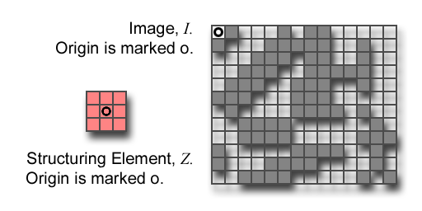
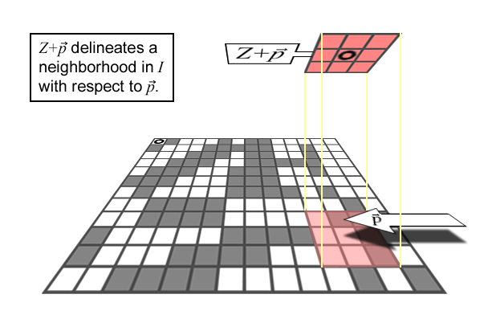
Recall: Binary Structuring Element (SE)
S _{p} is the set of of all pixel locations in the image.
Let I be an image and Z a SE.
Z+p means that Z is moved so that its origin coincides with location p in S_{P}.
Z+p is the translate of Z to location p in S_{P}.
The set of locations in the image delineated by Z+p is called the Z-neighborhood of p in I denoted N{I,Z}(p).

Slide 13
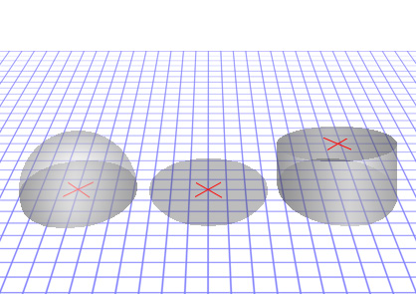
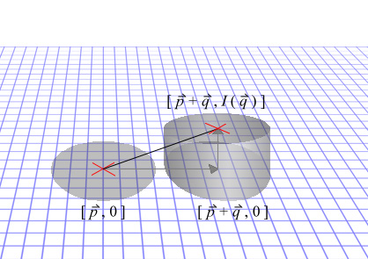
Grayscale Structuring Elements
A grayscale structuring element is a small image that delineates a volume at each pixel [p , I(p)] through out the image volume.
grayscale SE
translated flat SE
Translation of a flat SE on its support plane and in gray value.
flat SE
SE Translation: × marks the location of the structuring element origin.

Slide 14
Grayscale Structuring Elements
grayscale SE
translated flat SE
Translation of a flat SE on its support plane and in gray value.
flat SE
If Z = [ p, Z(p) ] is a structuring element and if q = [ q_{s}, q_{g} ] is a pixel [location, value] then Z+q = [ p+q_{s}, Z(p)+q_{g} ] for all p ∈ supp{Z}.

Slide 15
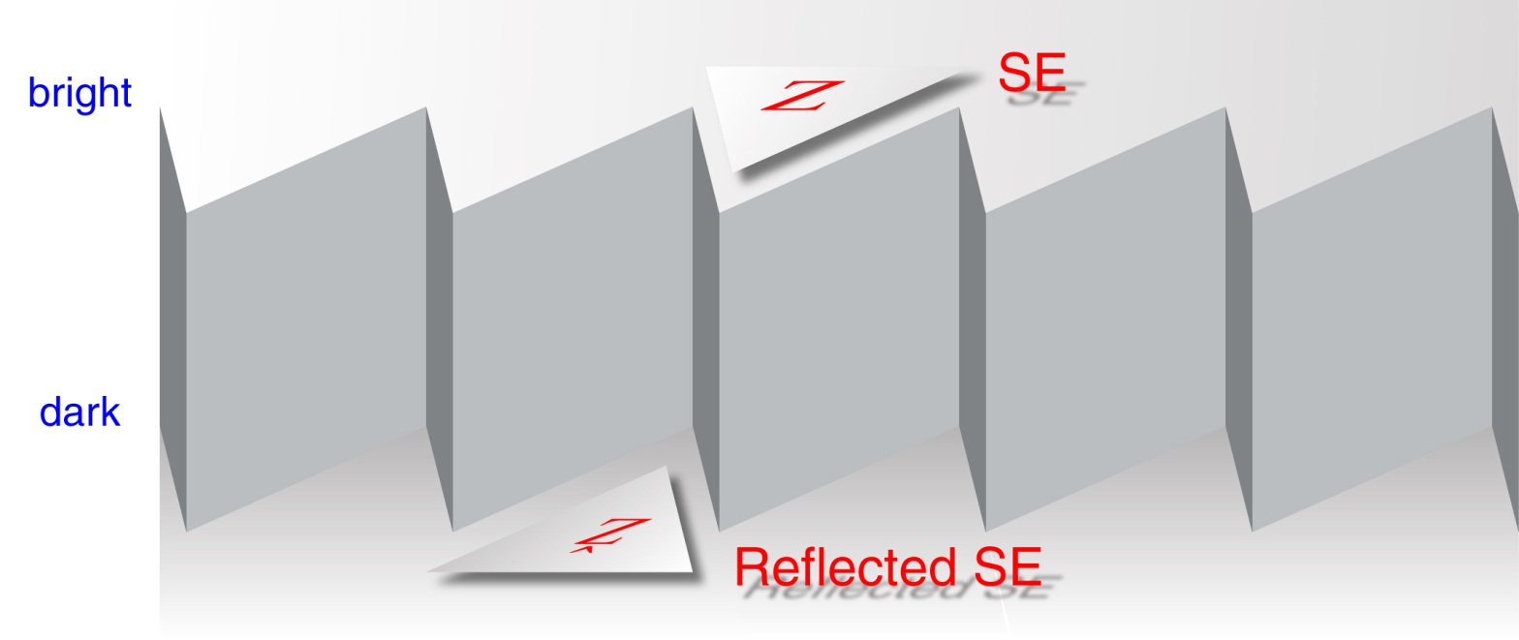
Reflected Structuring Elements
Note that the SE, Z, is to the bright regions…
… as the reflected SE, Ž, is to the dark regions.

Slide 16
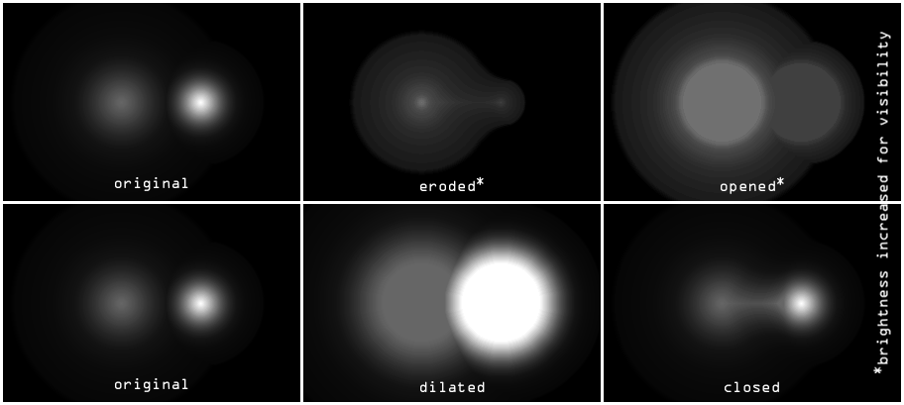
Grayscale Morphology: Basic Operations

Slide 17
Dilation: General Definition
The dilation of image I by structuring element Z at coordinate p^{n} is defined by
This can be computed as follows:
Translate Ž to p.
Trace out the Ž –neighborhood of I at p.
Let p be the origin of I temporarily during the operation
Compute the set of numbers
The output value, [I  Z](p), is the maximum value in the set, D.

Slide 18
Fast Computation of Dilation
The fastest way to compute grayscale dilation is to use the translates-of-the-image definition of dilation. That is, use
Note that if Z is flat -- all its foreground elements are 0 -- then step (3) is unnecessary. Then it is a maximum filter.
That is,
(1) Make a copy of I for each foreground element, q, in Z. (2) Translate the qth copy so that its ULHC (origin) is at position q in Z. (3) Add Z(q) to every pixel in the qth copy.
(4) Take the pixelwise maximum of the resultant stack of images.
(5) Copy out the result starting at the SE origin in the maximum image.

Slide 19
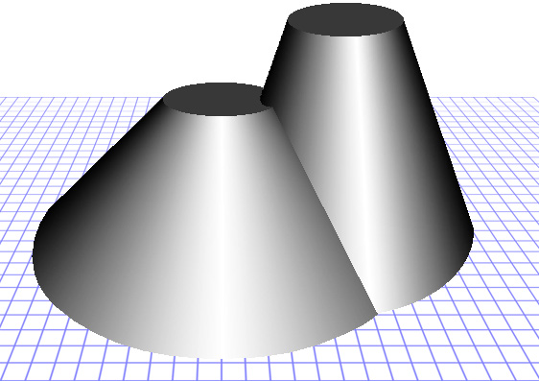
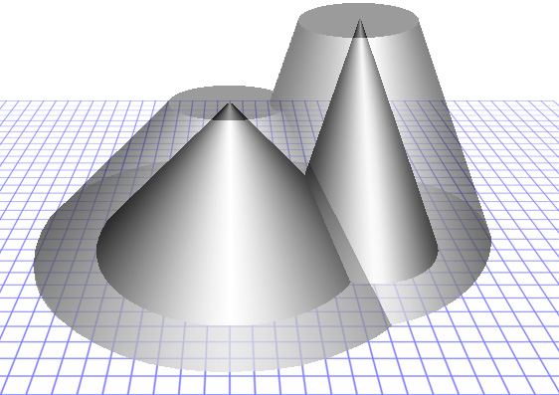
Grayscale Morphology: Dilation
dilation
dilation over original
SE, Z, is a flat disk the size of the tops of the truncated cones.
19

Slide 20
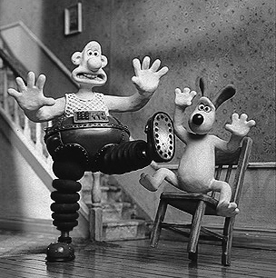
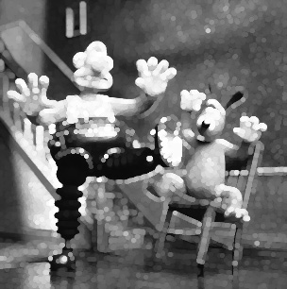
Grayscale Morphology: Dilation
SE, Z, is a flat disk.

Slide 21
Erosion: General Definition
The erosion of image I by structuring element Z at coordinate p^{n} is defined by
This can be computed as follows:
Translate Z to p.
Trace out the Z – neighborhood of I at p.
Let p be the origin of I temporarily during the operation
Compute the set of numbers
The output value, [I  Z](p), is the minimum value in the set, E.

Slide 22
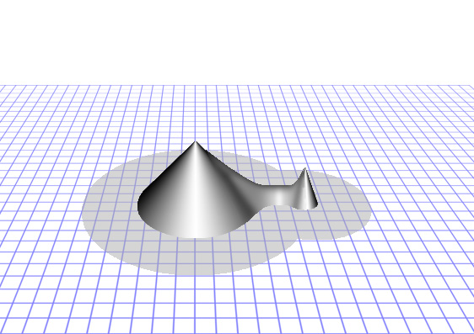
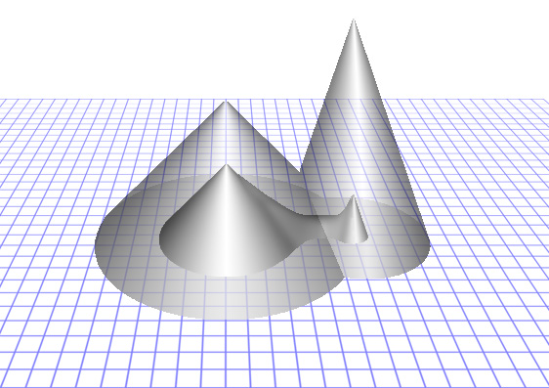
Grayscale Morphology: Erosion
erosion
erosion under original
SE, Z, is the same flat disk as used for the dilation on page 19.

Slide 23
Fast Computation of Erosion
The fastest way to grayscale erosion is to create a stack of images translated to minus the values of the reflected SE then take the pixelwise minimum:
Note that if Z is symmetric and if all the foreground elements are 0, then Ž=Z and step (3) is unnecessary. Then it is a minimum filter
That is, (1) make a copy of I for each foreground element, q, in Ž. (Note that if q is a foreground element in Ž then -q is a foreground element in Z.) (2) Translate each copy so that its ULHC (origin) is at position q in Ž (or -q in Z). (3) Then add Ž(q) (or subtract Z(-q)) to every pixel in the qth copy. Finally, (4) take the pixelwise minimum of the resultant stack of images.

Slide 24
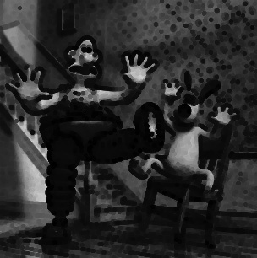
Grayscale Morphology: Erosion
SE, Z, is a flat disk.

Slide 25
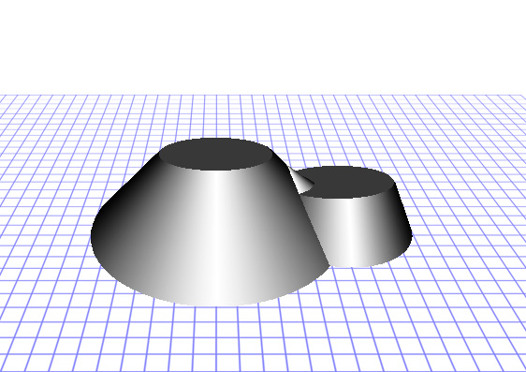
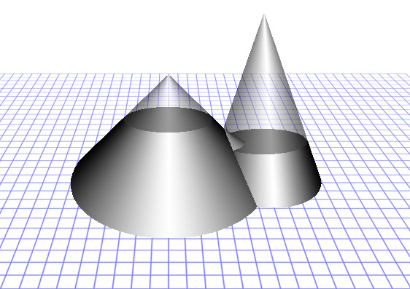
Grayscale Morphology: Opening
opening: erosion then dilation
opened & original
SE, Z, is a flat disk the size of the tops of the truncated cones.

Slide 26
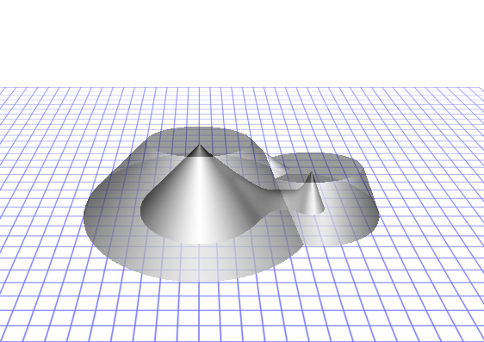
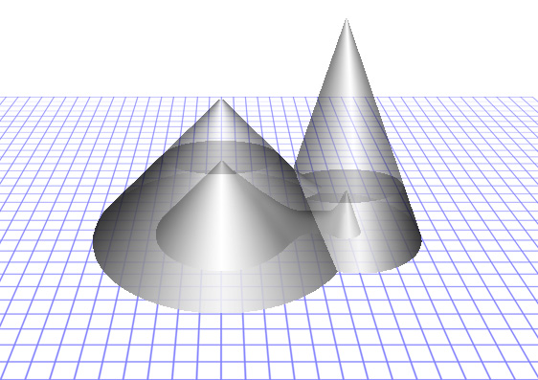
Grayscale Morphology: Opening
erosion & opening
erosion & opening & original
SE, Z, is a flat disk the size of the tops of the truncated cones.

Slide 27
Opening and Closing
Opening is erosion by Z followed by dilation by Z.
The opening is the best approximation of the image FG that can be made from copies of the SE, given that the opening is contained in the original. I □ Z contains no FG features that are smaller than the SE.
Closing is dilation by Ž followed by erosion by Ž.
The closing is the best approximation of the image BG that can be made from copies of the SE, given that the closing is contained in the image BG. I • Z contains no BG features that are smaller than the SE.

Slide 28
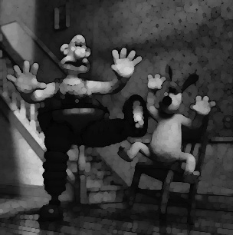
Grayscale Morphology: Opening
SE, Z, is a flat disk.

Slide 29
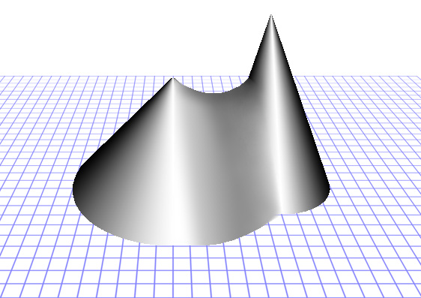
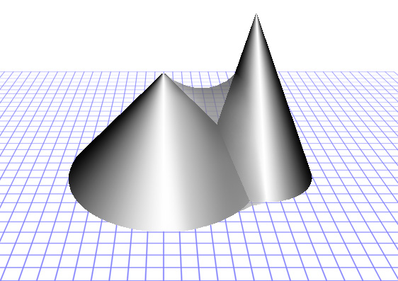
Grayscale Morphology: Closing
closing: dilation then erosion
closing & original
SE, Z, is the same flat disk as used for the dilation on page 19.

Slide 30
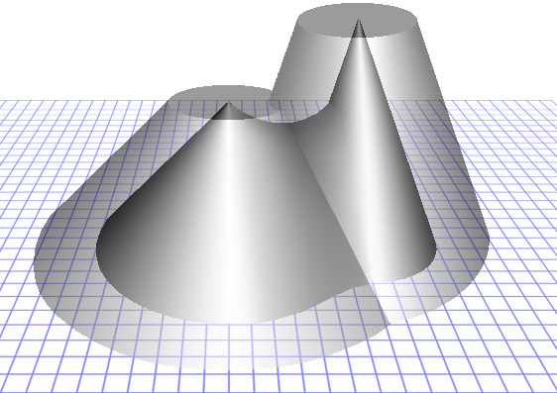
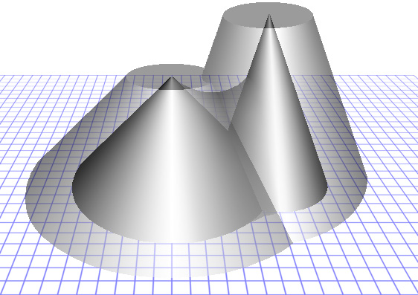
Grayscale Morphology: Closing
dilation over closing
dilation & closing & original
SE, Z, is a flat disk the size of the tops of the truncated cones.

Slide 31
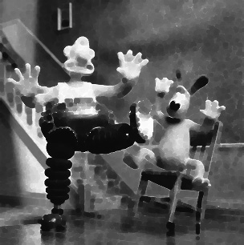
Grayscale Morphology: Closing
SE, Z, is a flat disk.

Slide 32
Duality Relationships
Erosion in terms of dilation:
Dilation in terms of erosion:
Opening in terms of closing:
Closing in terms of opening:
I^{C} is the complement of I and Ž is the reflected SE.

Slide 33
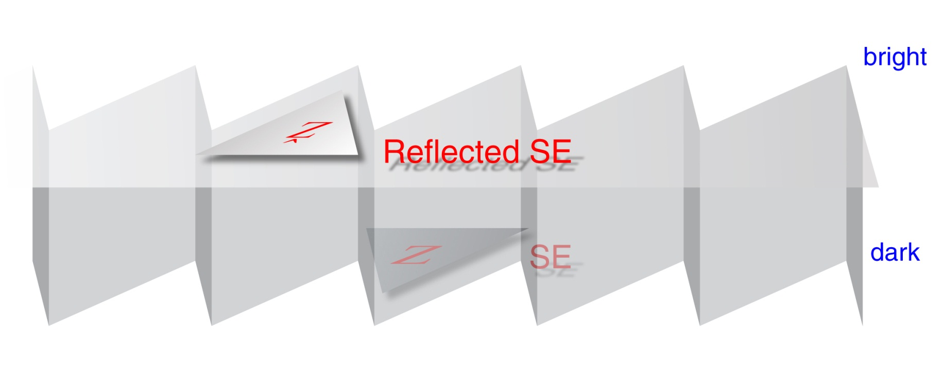
Duality Relationships
SE, Ž, operates on I^{C} as if it were Z operating on I.
SE, Z, operates on I^{C} as if it were Ž operating on I.

Slide 34
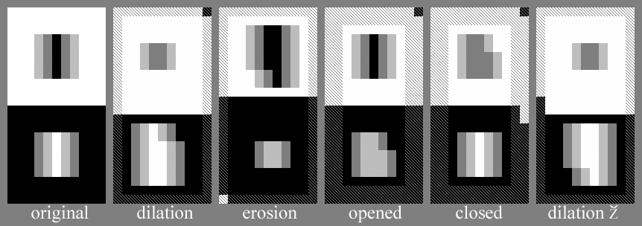
Gray Ops with Asymmetric SEs
“L” shaped SE
Foreground: white pixels
Cross-hatched pixels are indeterminate.
O marks origin
Background: black pixels

Slide 35
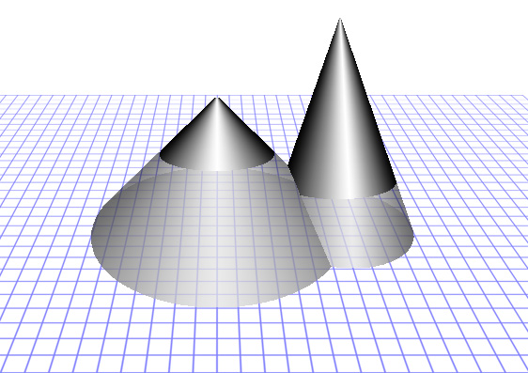
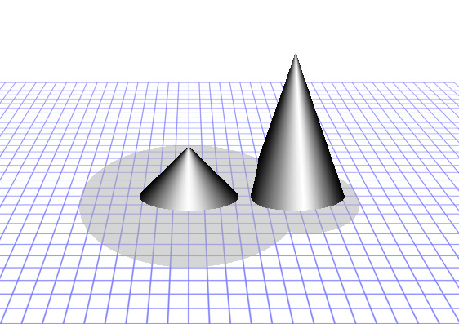
Grayscale Morphology: Tophat
tophat + opened = original
tophat: original - opening
SE, Z, is the same flat disk as used for the dilation on page 19.

Slide 36
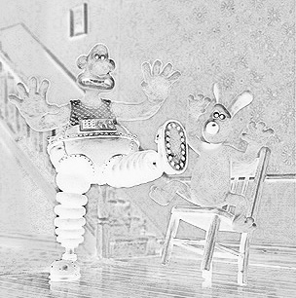
Grayscale Morphology: Tophat
shown as a negative for visibility
SE, Z, is a flat disk.

Slide 37
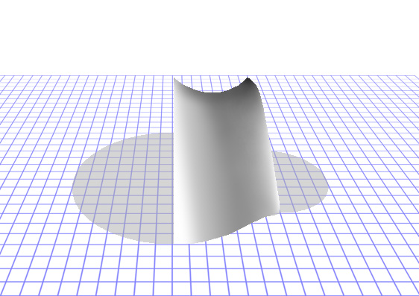
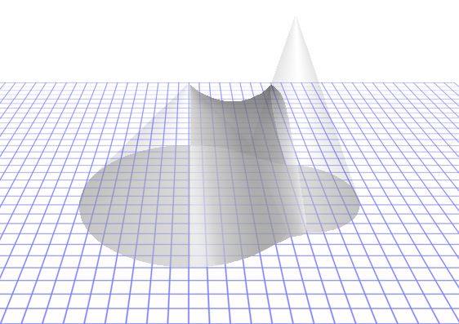
Grayscale Morphology: Bothat
region added by dilation
superimposed on original
SE, Z, is the same flat disk as used for the dilation on page 19.

Slide 38
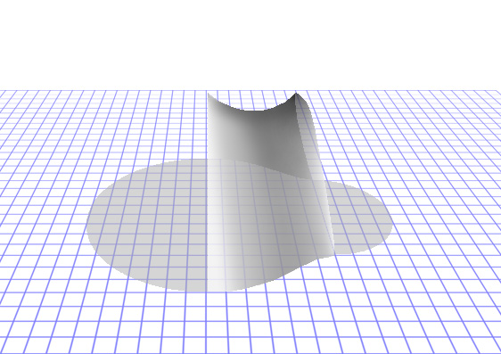
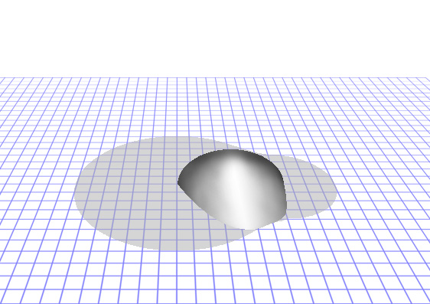
Grayscale Morphology: Bothat
region added by dilation
Bothat: closing - original
SE, Z, is the same flat disk as used for the dilation on page 19.

Slide 39
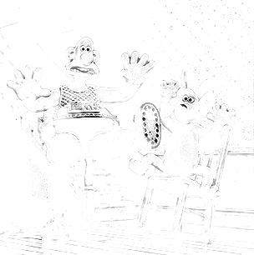
Grayscale Morphology: Bothat
shown as a negative for visibility
SE, Z, is a flat disk.

Slide 40
Grayscale Morphology: Tophat and Bothat
tophat
bothat
shown as negatives for visibility
SE, Z, is a flat disk.

Slide 41

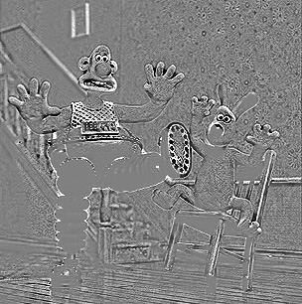
Grayscale Morphology: Small Feature Detection
original
tophat minus bothat
middle gray = 0
SE, Z, is a flat disk.

Slide 42
Algorithm for Grayscale Reconstruction
1. J = I □ Z , where Z is any SE.
2. T = J,
3. J = J  Z_{k} , where k=4 or k=8,
4. J = min{I, J}, [pixelwise minimum of I and J.]
5. if J ≠ T then go to 2,
6. else stop; [ J is the reconstructed image. ]
This is the same as binary reconstruction but for grayscale images J(r,c) ∈ I if and only if J(r,c) ≤ I(r,c).

Slide 43
Algorithm for Grayscale Reconstruction
Usually a program for reconstruction will take both J and I as inputs. E.g,
K = ReconGray(I,J,Z);
Then the algorithm starts at step 2.
1. J = I □ Z , where Z is any SE.
2. T = J,
3. J = J  Z_{k} , where k=4 or k=8,
4. J = min{I, J}, [pixelwise minimum of I and J.]
5. if J ≠ T then go to 2,
6. else stop; [ J is the reconstructed image. ]
This is the same as binary reconstruction but for grayscale images J(r,c) ∈ I if and only if J(r,c) ≤ I(r,c).

Slide 44
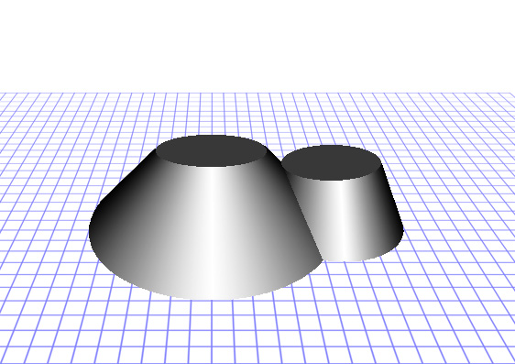
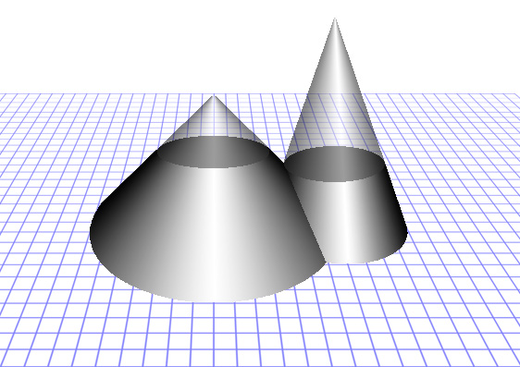
Grayscale Reconstruction
opened image
opened image & original
SE, Z, is a flat disk the size of the tops of the truncated cones.

Slide 45
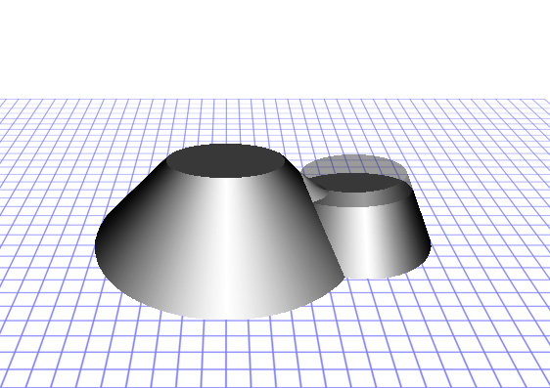

Grayscale Reconstruction
opened & recon. image
opened, recon., & original
SE, Z, is a flat disk the size of the tops of the truncated cones.

Slide 46
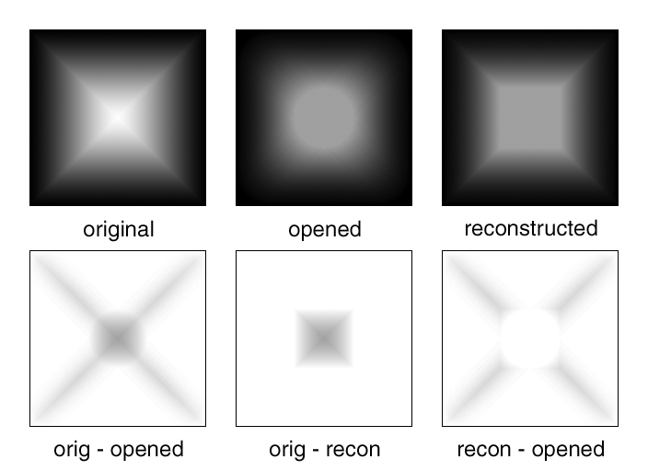
Grayscale Morphology: Reconstruction
SE, Z, is a flat disk.

Slide 47
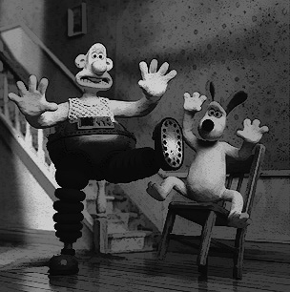
Grayscale Reconstruction
original
reconstructed opening
SE, Z, is a flat disk.

Slide 48
Grayscale Reconstruction
opening
original
SE, Z, is a flat disk.

Slide 49
Grayscale Reconstruction
reconstructed opening
opening
SE, Z, is a flat disk.

